Slide 1
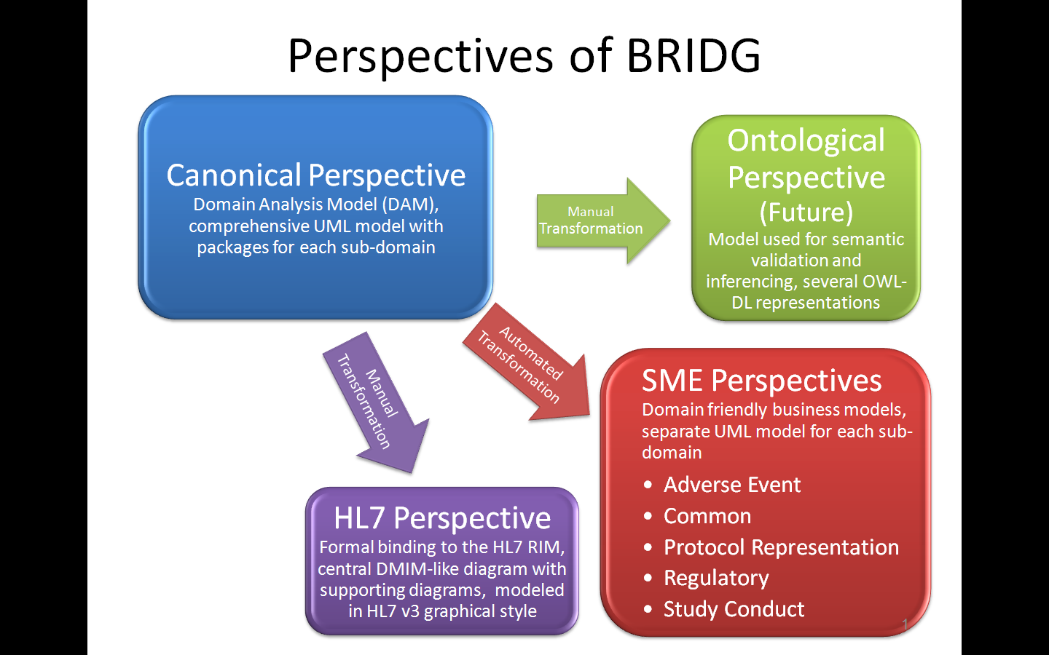
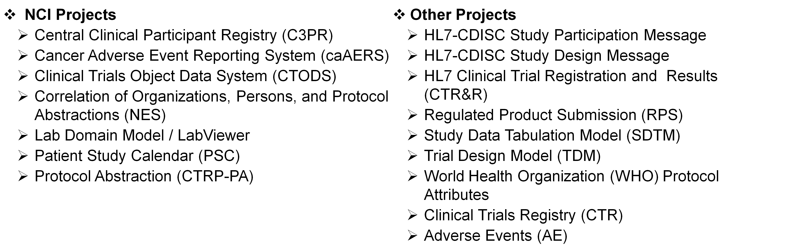
BRIDG: An International Standard Model for Protocol-Driven Research
BRIDG Semantic Coordination Committee (SCC): Becky Angeles, ScenPro, Inc.; Julie Evans, CDISC; Smita Hastak, ScenPro, Inc.; Lloyd McKenzie, Gordon Point Informatics; Charlie Mead, NCI CBIIT; Steve Sandberg, ScenPro, Inc.; Wendy Ver Hoef, ScenPro, Inc.; Mike Woodcock, Mayo Clinic NCI CBIIT: Christo Andonyadis; John Speakman; SAIC-F: Steve Silberman
Overview of the Biomedical Research Integrated Domain Group (BRIDG) Model
The BRIDG Model is a collaborative effort of stakeholders from the Clinical Data Interchange Standards Consortium (CDISC), the HL7 Regulated Clinical Research Information Management (RCRIM) Work Group, the National Cancer Institute (NCI), and the US Food and Drug Administration (FDA) to produce a shared view of the dynamic and static semantics that collectively define a shared domain-of-interest. The model is currently being balloted as ISO 14199 through ISO/TC215..
The BRIDG model is an instance of a Domain Analysis Model (DAM). As such, it depicts a shared representation of the dynamic and static semantics of a particular domain-of-interest. In the case of the BRIDG model, the domain is defined as:
    Protocol-driven research and its associated regulatory artifacts, i.e. the data, organization, resources, rules, and processes involved in the formal assessment of the utility, impact, or other pharmacological, physiological, or psychological effects of a drug, procedure, process, subject characteristic, biologic, cosmetic, food or device on a human, animal, or other subject or substance plus all associated regulatory artifacts required for or derived from this effort, including data specifically associated with post-marketing adverse event reporting.
BRIDG at NCI
The Multiple Perspectives of BRIDG
As NCI-CBIIT moves further into the semantically-aware Service Oriented Architecture with the adoption of the HL7 Services-Aware Interoperability Framework (SAIF), the requirement for sharing data and supporting functional integration across the health care domain will be the key to success. A key component of the SAIF’s Information Framework are Domain Analysis Models (DAM). These DAMs are the basis for the Information Viewpoint in RM-ODP and they provide the foundation for building the Semantic Profiles in the Enterprise Conformance and Compliance Framework (ECCF) service specifications.
The NCI has adopted the BRIDG model as the DAM for all static semantics in the Clinical Trials domain. At NCI, the BRIDG is referred to as the DAM as well as the Design Information Model. The NCI’s Enterprise Services (NES) of Person, Organization and Protocol and all new services that are being defined in the clinical domain for the Suite and the Clinical Trials Reporting Program (CTRP) are being bound to BRIDG model semantics. This model forms the semantic basis of the ECCF service specification stack. The CIM, PIM and PSMs for the various services present the constrained versions of the BRIDG model with ISO 21090 data types and vocabulary bindings. There are plans to combine the behavioral/use-case/process data in the CTMS BAM with the static semantics in BRIDG to produce a single integrated Clinical Sciences Analysis Model for NCI.
The BRIDG Model is increasingly being referenced by domain experts as the ‘standard’ for defining the semantics of “Protocol-Driven Research and associated regulatory artifacts”. BRIDG is also increasingly being used by developers as a basis for both application and data interchange development. The increased scrutiny by both domain experts and developer communities for a model that ‘makes sense’ to each, given their perspective on the notion of ‘shared semantics in a well-defined domain,’ has led to the development of multiple perspectives (layers) of the BRIDG Model.
The Canonical Perspective is the BRIDG Domain Analysis Model composed of sub-domain specific views, and one Enterprise Comprehensive View. The SME Perspective is comprised of several sub-domain specific business models (domain friendly). The Ontological Perspective is an OWL-DL representation of the BRIDG Model. The HL7 Perspective is the HL7 Reference Information Model (RIM)-based BRIDG Model represented in HL7’s diagramming representation and is equivalent to an HL7 DMIM.
Projects Harmonized in BRIDG
Current Status
BRIDG R3.0.2 was released in August 2010
The BRIDG Model passed the initial ISO Joint Initiative Council ballot as a Draft International Standard (DIS) in May, 2010. The BRIDG SCC is currently addressing the 250 comments received to proceed to the next phase of balloting.
For More Information
Learn more and download the model from: www.bridgmodel.org
BRIDG User’s Listserv: BRIDG_USERS@list.nih.gov
BRIDG SCC Listserv: BRIDGTHC-L@list.nih.gov

